Slide 1
IT Security Training

Slide 2



Why?
Create awareness
Protect you both at home and here

Slide 3
Topics
Passwords
MFA/2FA
Malware
Backup Data
Phishing

Slide 4
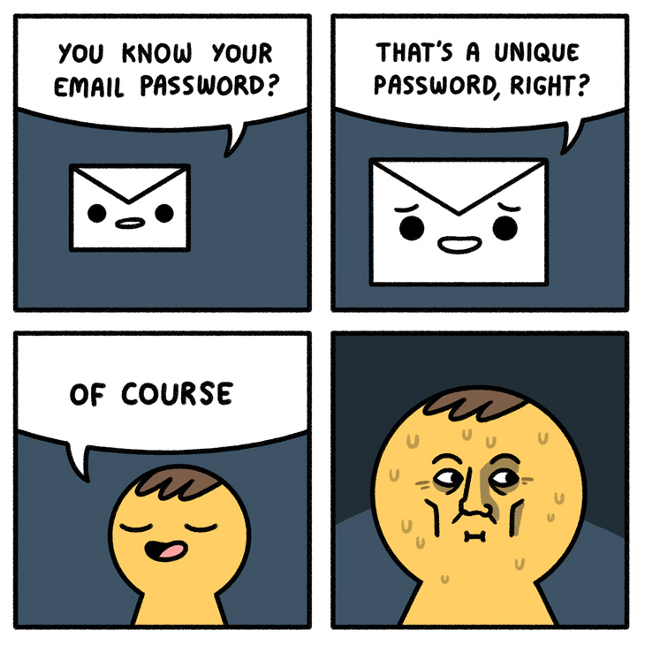
Passwords
Don’t use the same password across (important) services
Passwords are easier to crack
In 2015 an 8 character password can be figured out in less than 26 minutes if it is based off a word like P@55w0rD

Slide 5
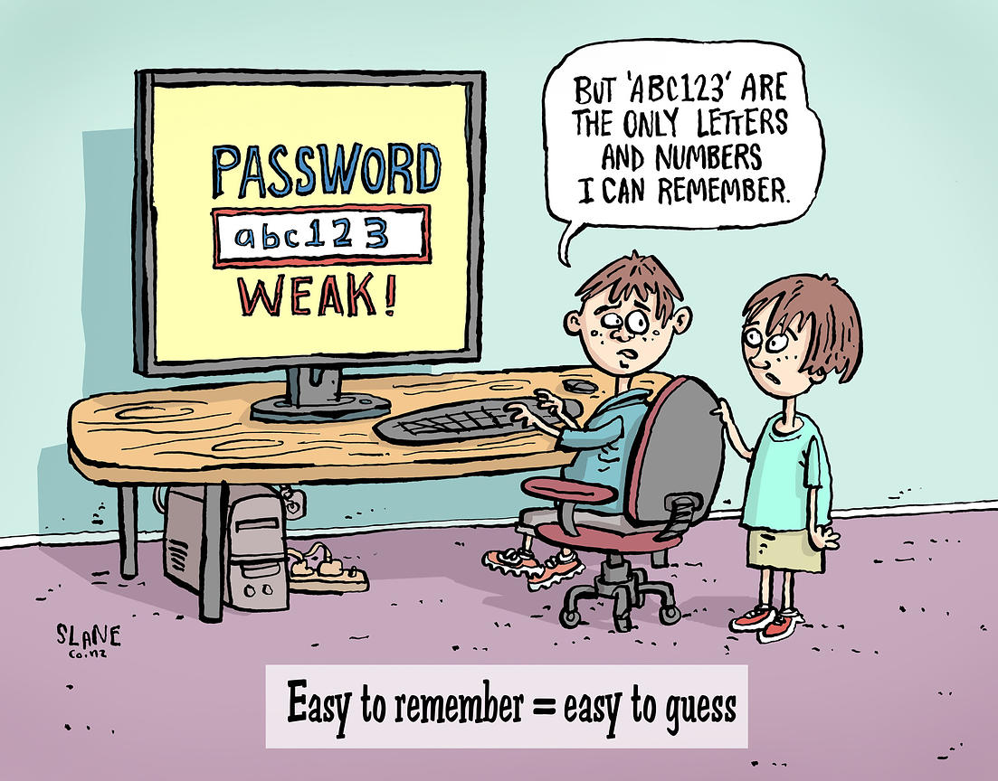
Passwords (Work)
Most things sign in automatically
Right now we have:
REDACTED

Slide 6
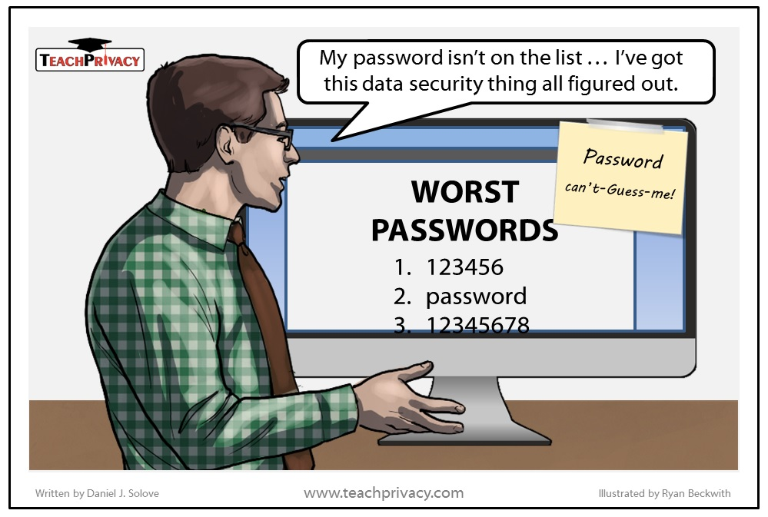
Passwords (Work)
What we are going to be moving to:
REDACTED

Slide 7
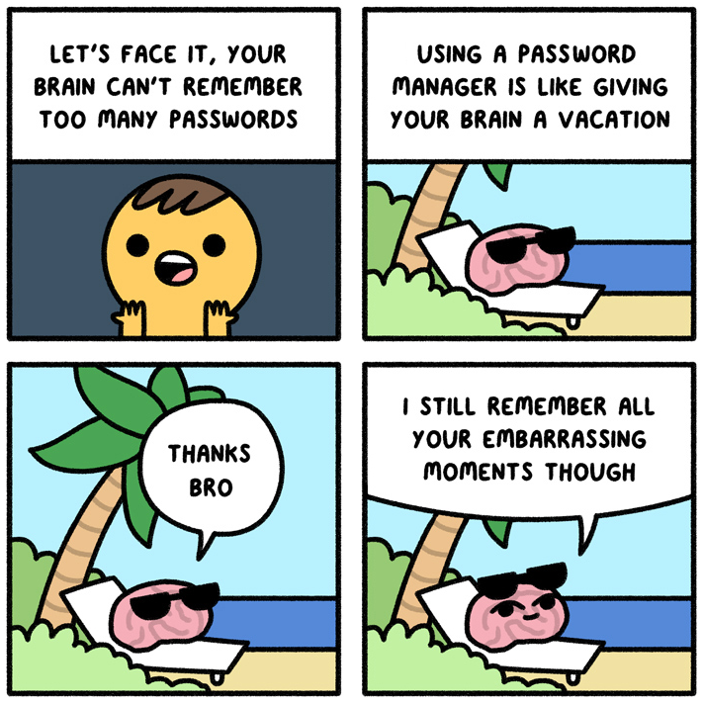
Passwords (Personal)
How can you protect yourself?
Password managers are great!
Multiple variations for ease of use
Creates automatic strong passwords for you
Autofill Passwords
www.HaveIBeenPwned.com

Slide 8
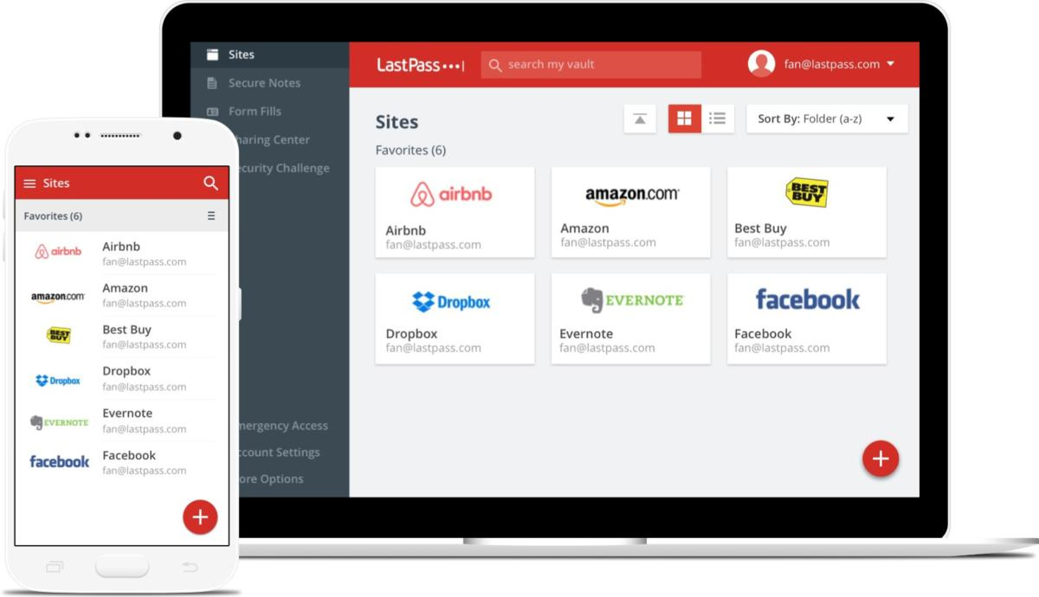

Slide 9
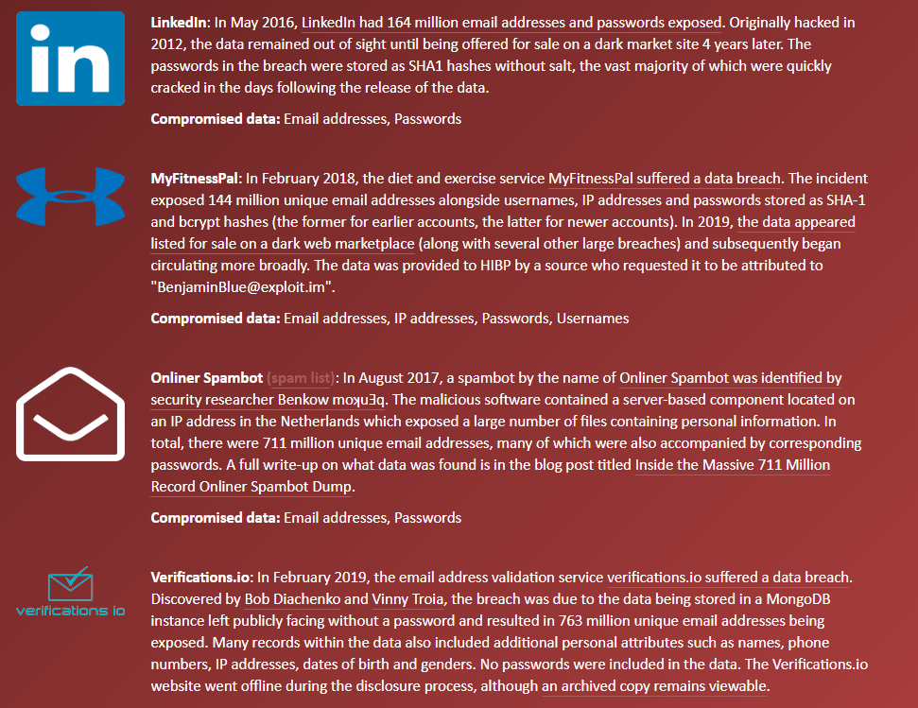

Slide 10
Looking into our passwords REDACTED

Slide 11
REDACTED

Slide 12
Looking at our passwords
How many passwords could I get in a few seconds?
How many passwords could I get in a few days?

Slide 13
2FA - 2 Factor Authentication
2FA is a secondary passcode
Used when logging in (normally when a new device is used)
Used to confirm important things (e.g. Bank transfers)
Phone text message
Email message
Authenticator App

Slide 14
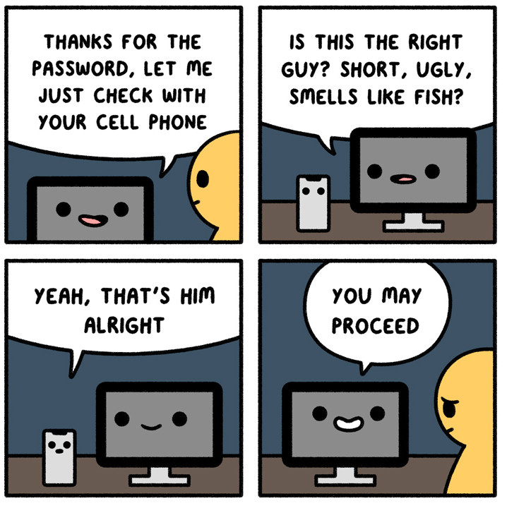
2FA (Personal)
If it exists, use it (within reason)
Enable it on anything you think is important
Most emails, banks, social media have 2FA

Slide 15
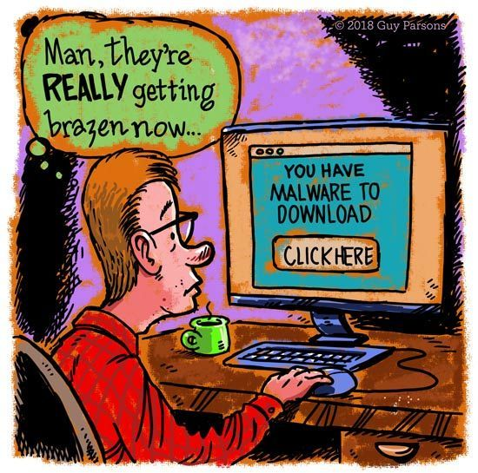
Malware
Malicious software
Can come in all shapes and sizes
Ransomware
Adware

Slide 16
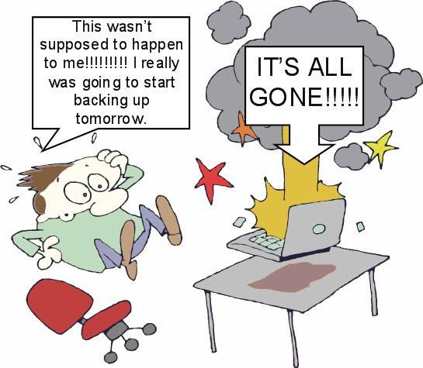
Malware Prevention (Work)
Backups (REDACTED)
Antivirus
If something doesn’t look right, let us know
It’s better to be overcautious
REDACTED

Slide 17
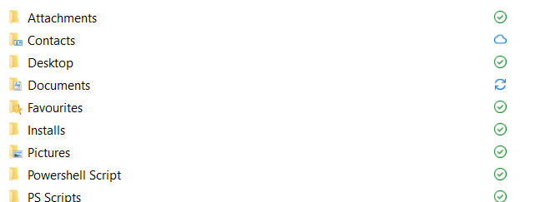
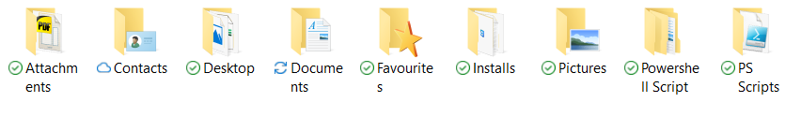
.

Slide 18
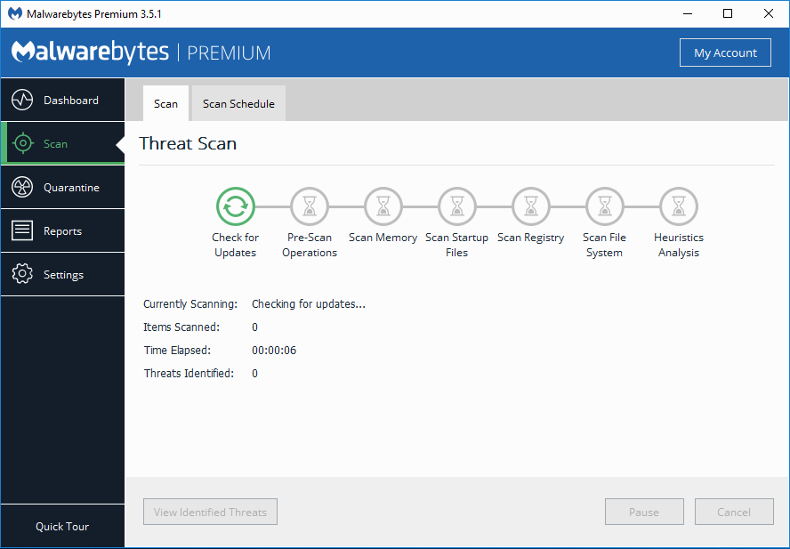
Malware Prevention (Personal)
Install Malwarebytes
Back up important data
Read what you’re installing (Adware)
If it looks sketchy avoid it

Slide 19
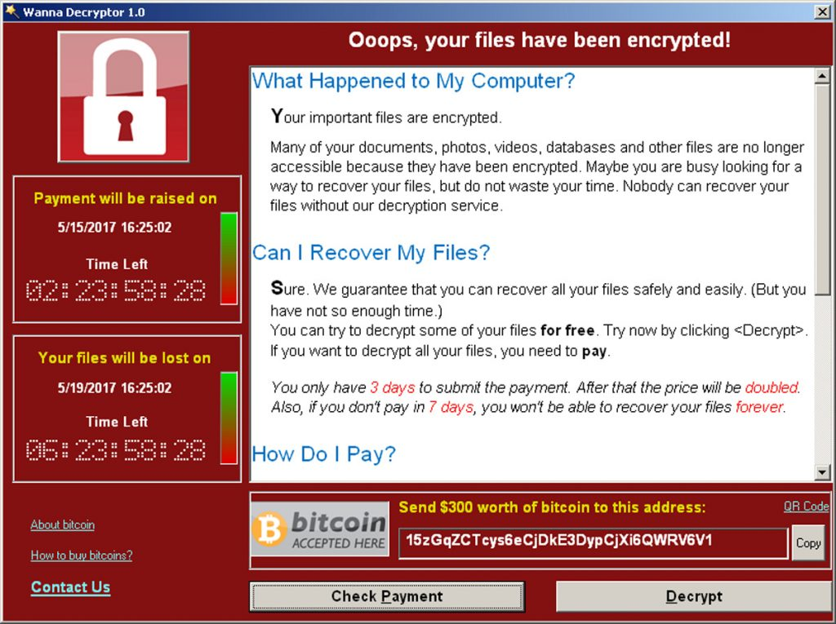

Slide 20
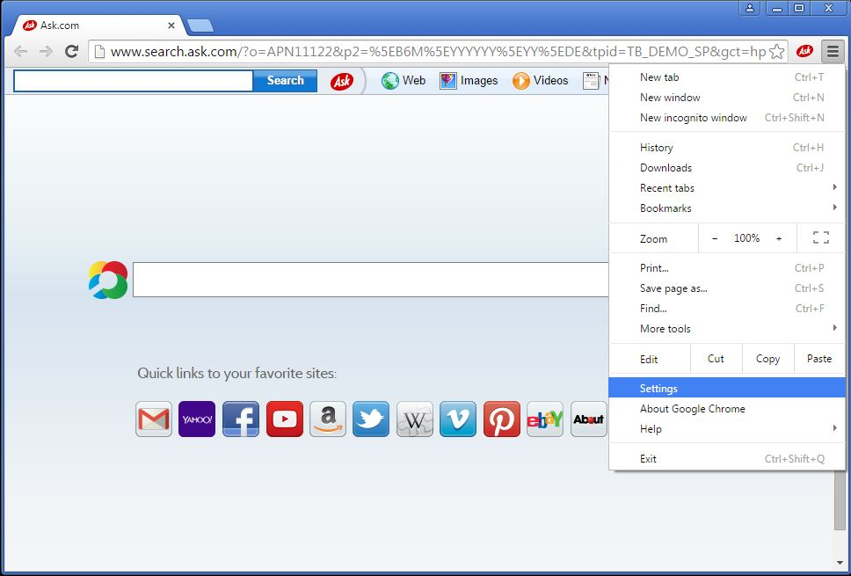

Slide 21
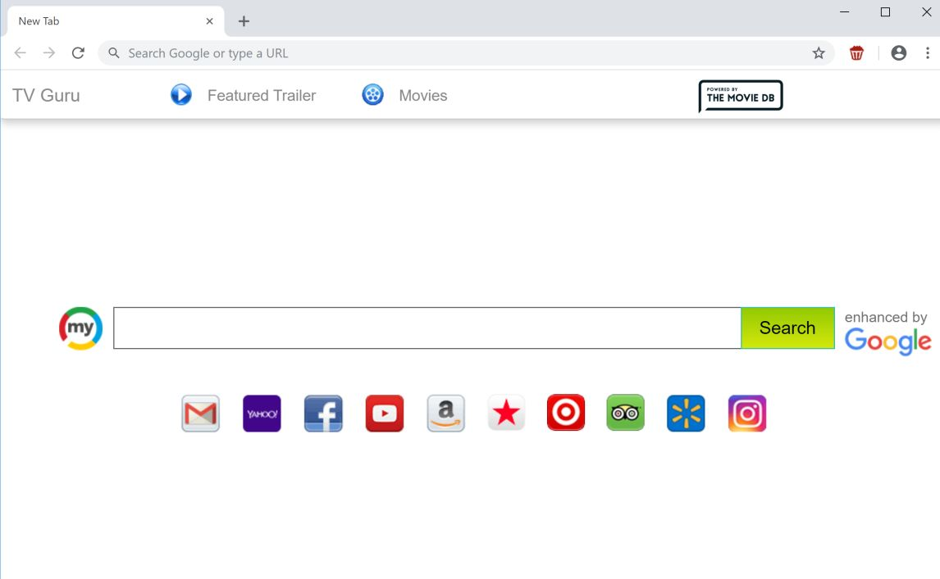

Slide 22
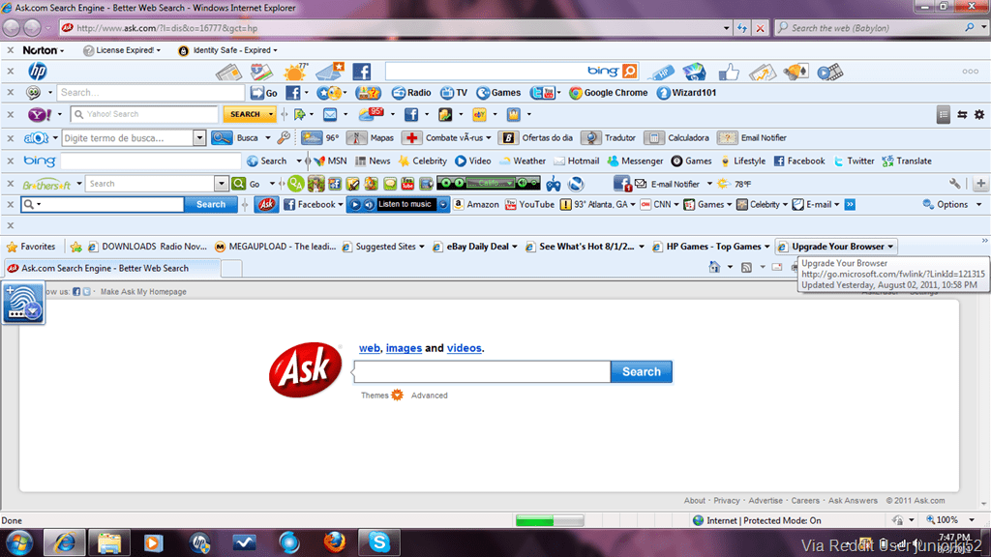

Slide 23
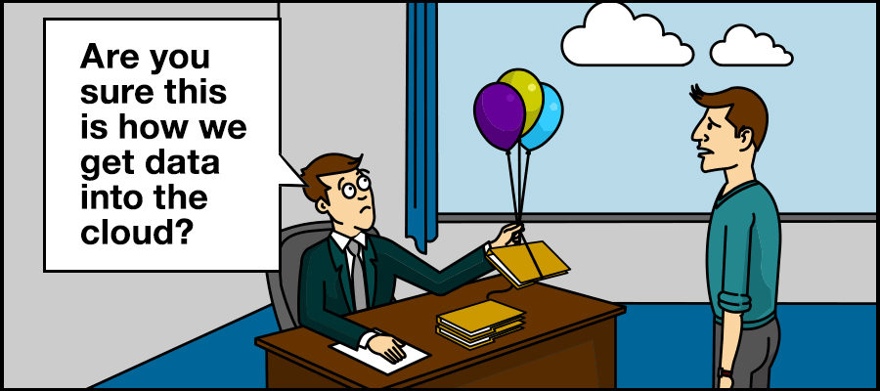
Data Backup
Back up your important data
Computers are unreliable
Hard drives are cheap
Back it up and store it somewhere
iCloud, Google Cloud, Dropbox

Slide 24
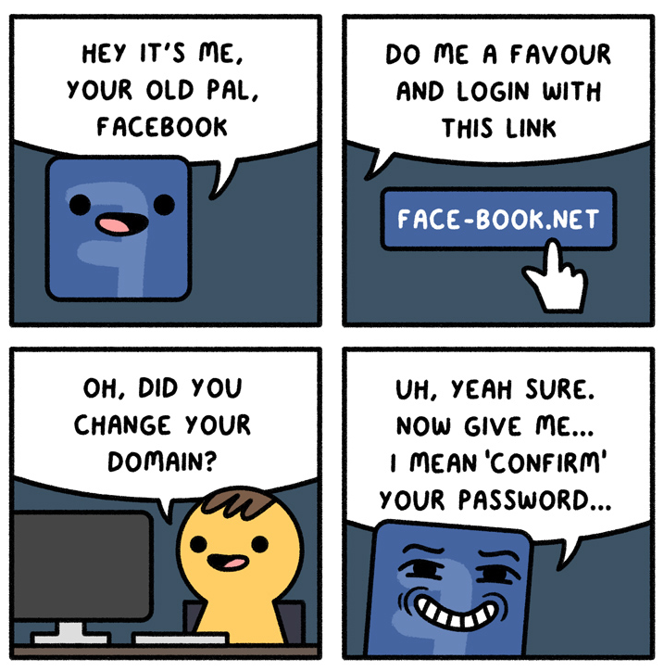
Phishing
What is it?
Why?
How?
What can be done to prevent it?

Slide 25
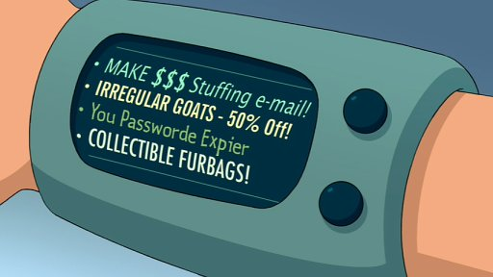
Phishing – What is it?
Emails sent to try and get your username and password or more
Gather information or money

Slide 26
REDACTED
Screenshot of external phishing email

Slide 27
REDACTED
Screenshot of external phishing email

Slide 28
REDACTED
Screenshot of external phishing email

Slide 29
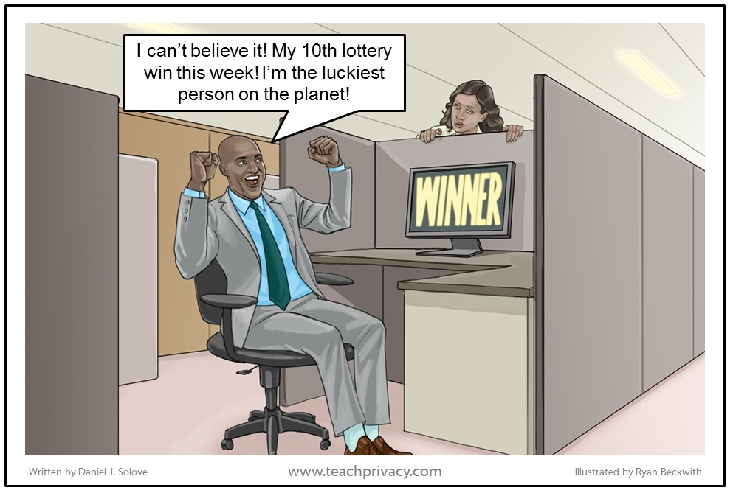
Phishing – Why?
Gather data or money ($50,000)
Usernames, passwords, credit card numbers, addresses, phone numbers, drivers license numbers
Identity theft
Break into companies
Cause chaos/damage

Slide 30
REDACTED
Screenshot of external phishing email

Slide 31
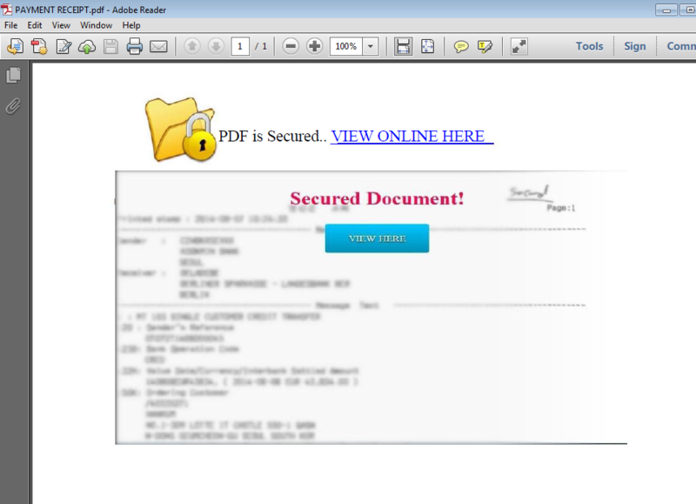
Phishing
Attachments with viruses are normally caught by our firewall
Request you to sign in
Some get past our protections

Slide 32
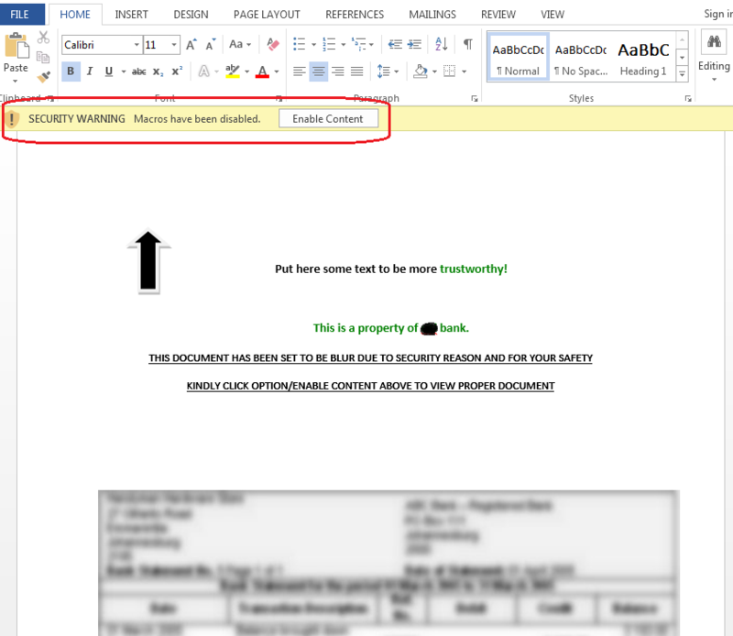

Slide 33
Phishing – How?
It’s very easy
Email has flaws – Email spoofing
Only takes a few minutes to send thousands of emails

Slide 34
REDACTED
Screenshot of internal phishing email

Slide 35
REDACTED
Screenshot of internal phishing email

Slide 36
REDACTED
Screenshot of internal phishing example

Slide 37
REDACTED
Screenshot of internal phishing email

Slide 38
REDACTED
Screenshot of internal phishing email results

Slide 39
REDACTED
Screenshot of internal phishing email

Slide 40
REDACTED
Screenshot of internal phishing email

Slide 41
REDACTED
Screenshot of internal phishing email

Slide 42
REDACTED
Screenshot of internal phishing email

Slide 43
REDACTED
Screenshot of internal phishing email

Slide 44
REDACTED
Screenshot of internal phishing results

Slide 45
Phishing (Who notified us)
REDACTED NAMES

Slide 46
REDACTED
Screenshot of internal phishing email

Slide 47
REDACTED
Screenshot of internal phishing email

Slide 48
REDACTED
Screenshot of internal phishing email

Slide 49
REDACTED
Screenshot of internal phishing email

Slide 50
REDACTED
Screenshot of internal phishing email results

Slide 51
Reporters
REDACTED NAMES

Slide 52
Phishing
From there you were sent to:
Your already logged in page
The actual page as if a password was incorrect
No indication something bad has happened

Slide 53
Phishing – Preventing it
If something looks off, let us know (is Facebook set up to your work email?)
For any emails that pretend to be REDACTED this notification is on it
We try to catch any of the bad emails
Training and Testing
Reporting system – REDACTED

Slide 54
REDACTED
Screenshot of external phishing email

Slide 55
REDACTED
Screenshot of external phishing email

Slide 56
Phishing (Personal)
Be careful what you open
If something looks off, don’t open it
After receiving the email, go through google and find the link
Check everything if you’re putting in important info (drivers license, bank details etc..)

Slide 57
Recap
Passwords – complex and different (password manager)
2FA – Use it wherever necessary
Malware – Malware bytes
Backup – Hard drive, cloud storage
Phishing – If unsure, report it

Slide 58
Questions?
Feel free to email me for more information any time

